Slide 1
The Pivot
The Pivot

Slide 2
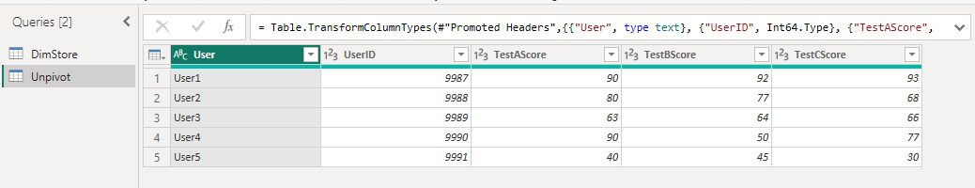
Pivot
Note: This lab uses the Score.xlsx file located in the resources \Advanced Transformations folder .
Load the dataset​​ Unpivot and edit it in Power Query M

Slide 3
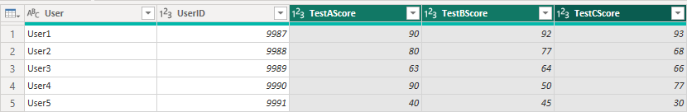
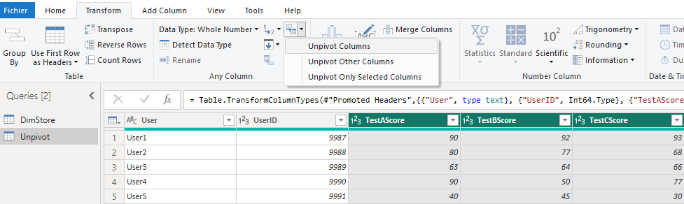
Pivot
Select the three columns TestAScore , TestBScore and TestCScore
Click Unpivot Columns in the Transform

Slide 4
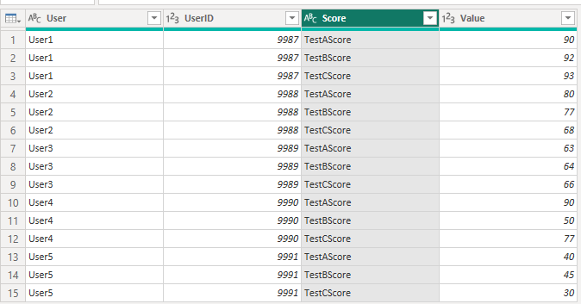
Pivot
The result should look like the result below, you just need to change the name of the new column
attribute by Score

Slide 5
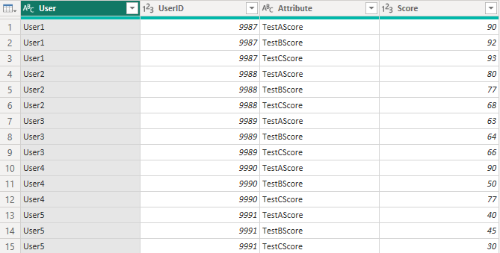
Pivot
Now load the Pivot table

Slide 6
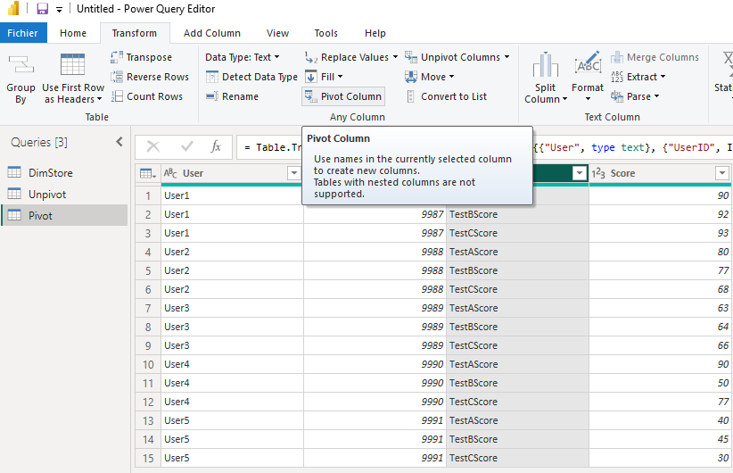
Pivot
Select the Pivot source in the Power Query M editor

Slide 7
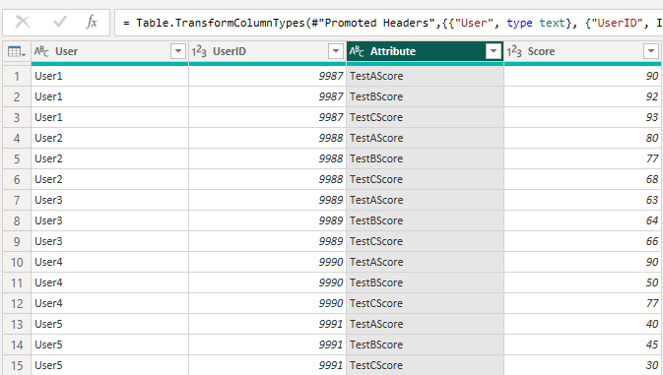
Pivot
Select the attribute column

Slide 8

Pivot
Select Pivot Column from the Transform menu

Slide 9
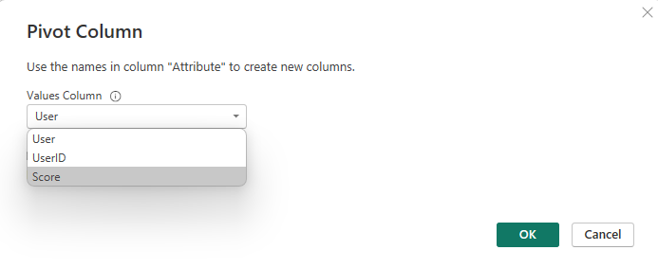
Pivot
Select Score in the dialog box

Slide 10
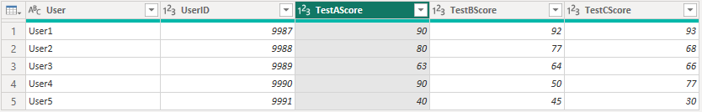
Pivot
Check the Pivot result

Slide 11
Thank you
Thank you

